Slide 1









CDCS Hamburg-X Project (BWFGB)
Associated Partner
CDL4
CDCS
CDL3
CCU
CDL1
CDL2

Slide 2
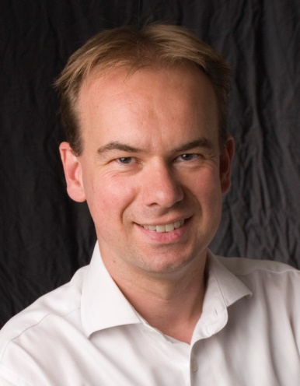
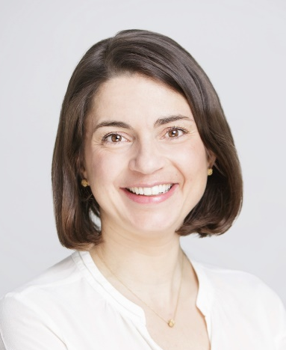
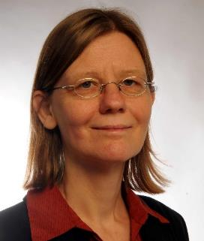
CDCS Structure
UHH Project Coordinator
DESY Project Coordinator
TUHH Project Coordinator
Prof. Dr. Matthias Rarey
UHH Computer Science
Spokesperson CDCS
Prof. Dr. Nina Rohringer
DESY / UHH Physics
Prof. Dr. Sabine Le Borne
TUHH Mathematics
Accelerator Physics
Head: Prof. Fey (TUHH) / Prof. Schlarb (DESY)
CDL4
CDCS
Systems Biology
Head: Prof. Grünewald (UHH)/ Prof. Baumbach (UHH)
Computational Core Unit
Head: Prof. Rarey (UHH)/ Prof. Knopp (TUHH)
CDL3
CCU
Astro & Particle Physics
Head: Prof. Schleper (DESY)/
Dr. Gaede (UHH)
CDL1
CDL2
Photon Science
Head: Dr. Barty (DESY)/
Dr. White (DESY)

Slide 3
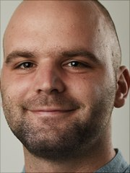
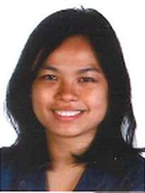

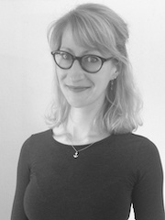
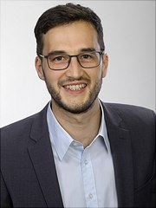
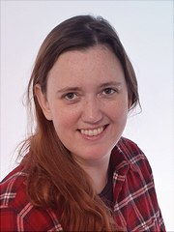
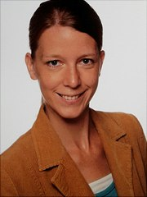
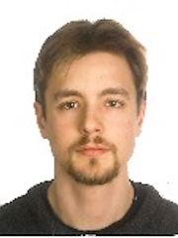
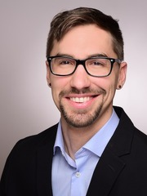

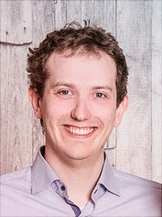
CDCS and CDLs in Detail
Accelerator Physics
Head: Prof. Fey (TUHH) / Prof. Schlarb (DESY)
CDL4
Dr. Antonin Sulc
Dr. Ahmad Al-Zoubi
CDCS Miriam Döring
Systems Biology
Head: Prof. Grünewald (UHH)/ Prof. Baumbach (UHH)
Computational Core Unit
Head: Prof. Rarey (UHH)/ Prof. Knopp (TUHH)
CDL3
CCU
CDL1
CDL2
Dr. Karen M.-Cantos
Dr. Khalique Newaz
Dr. Marie Tolkiehn
Scientific-administrative Management
Dr. Florian Griese
Dr. Annett Ungethüm
Astro & Particle
Physics
Head: Prof. Schleper (DESY)/
Dr. Gaede (UHH)
Photon Science
Head: Dr. Barty (DESY)/
Dr. White (DESY)
Dr. Patrick Connor
Dr. Janis Kummer
Dr. Lennart Rustige
Dr. Mads Jakobsen
N.N

Slide 4
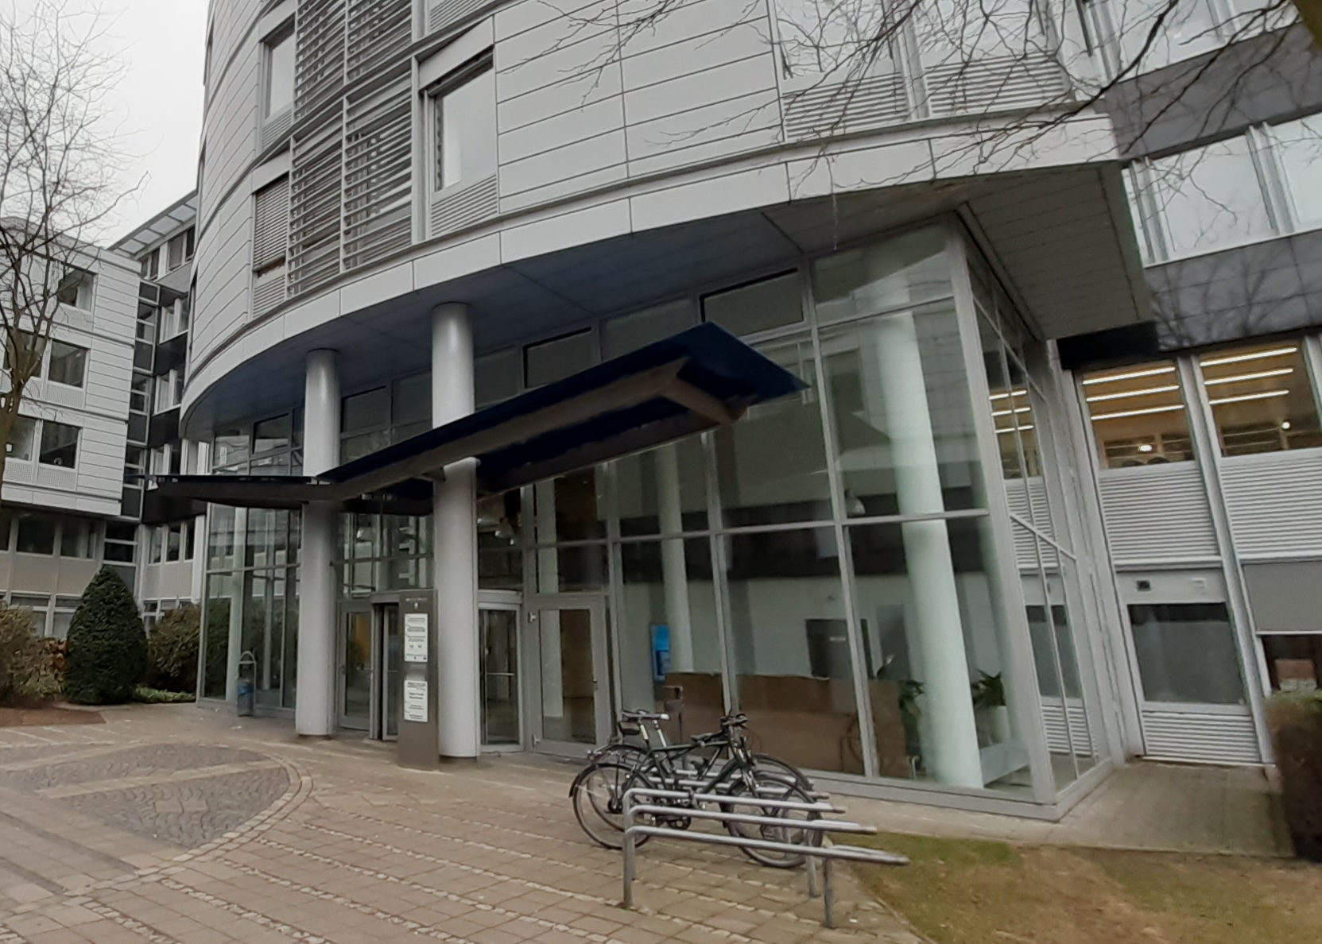
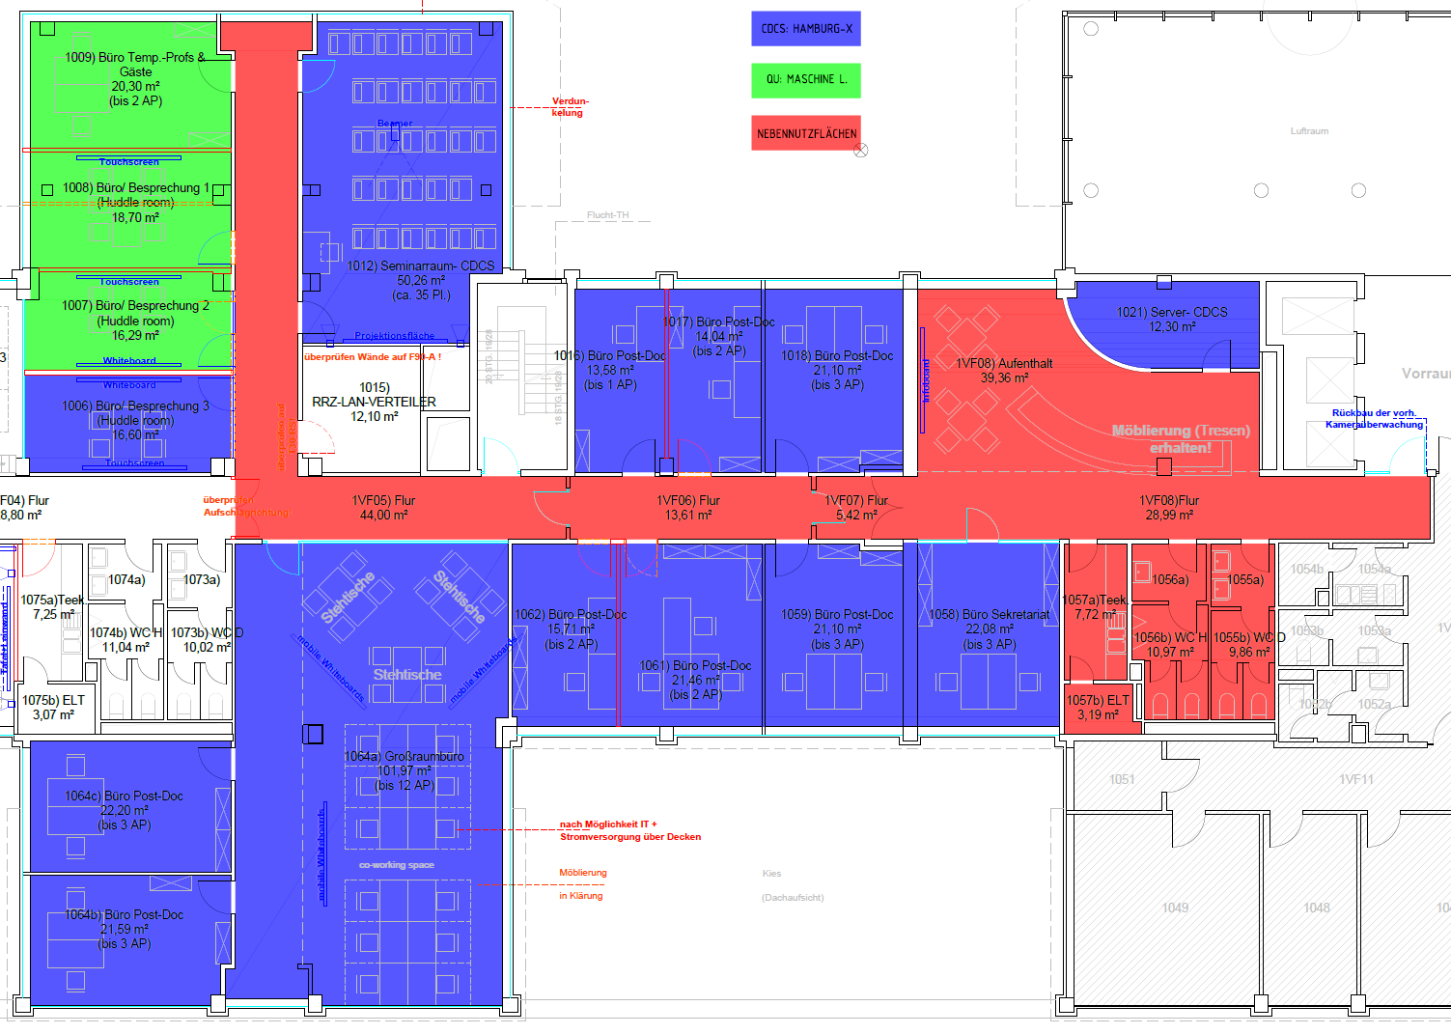
The CDCS Office Space
As a DASHH student you can
get a transponder to the CDCS hot desk office space (room 1064,
Notkestr. 9-11)
Ask our secretary Miriam Döring:
miriam.doering@uni-hamburg.de

Slide 5
One node with
One GPU
One node with
multiple GPUs
Multiple nodes with multiple GPUs
GPU
GPU
GPU
GPU
GPU
GPU
GPU

Slide 6
One node with
One GPU
One node with
multiple GPUs
Multiple nodes with multiple GPUs
GPU
GPU
GPU
GPU
GPU
GPU
GPU

Slide 7


GPU

Slide 8
real Data
Wasserstein GAN
GAN
Evaluation
Feedback to
improve GAN
generated
Images
new batch
Data
Train
Valid
Test
Analysis on
generated images and
Statistical Significance
of improvement
Model
Engineering
FC
FC
Comparison to
Baseline Model Performance with only real Data
Model Evaluation
Precision, Recall,
F1 score,Brier score
CNN
CNN
ViT
ViT
Selection best Model
Prediction
Code, Params

Slide 9
real Data
Wasserstein GAN
Feedback to
improve GAN
GAN
Evaluation
Feedback to
improve GAN
generated
Images
new batch
Data
Train
Valid
Test
Analysis on
generated images and
Statistical Significance
of improvement
Model
Engineering
FC
FC
Comparison to
Baseline Model Performance with only real Data
Model Evaluation
Precision, Recall,
F1 score,Brier score
CNN
CNN
ViT
ViT
Selection best Model
Prediction
Code, Params

